Slide 1


Eye-tracking-based adaptation for personalized game-based learning within intelligent educational environments
Boyan Bontchev, Dessislava Vassileva, and Valentina Terzieva-Bogoycheva
FMI – Sofia University “St Kl. Ohridski”
IICT – Bulgarian Academy of Sciences
AMEE’2025
Sozopol, Bulgaria
June 7-13, 2025

Slide 2
Agenda
Educational video games
Player-centric adaptation of educational video games
Previous research of the team
Emotion-based dynamic adaptation control
Affect inferred by psychophysiological signals
Emotions inferred by visual expressions analysis
Emotion-based game adaptation
Current research in the scope of the MOTIVATE project
Eye-tracking-based game adaptation
Important issues
Conclusion

Slide 3
Educational video games
Serious/applied video games for education purposes
Features:
Engagement & Motivation – interactive gameplay increases student interest and participation.
Personalized Learning – AI-driven adaptations cater to individual learning styles.
Critical Thinking & Problem-Solving – Games foster decision-making skills and strategic thinking.
Language & STEM & Arts & Soft Skills Development – integrates science, technology, engineering, and mathematics with creativity and collaboration.
Immersive Learning Experiences – virtual environments enhance concept retention and application.
💡 “Learning is most effective when it’s fun and interactive!” – Dr. Susan Curtiss

Slide 4

Player-centric adaptation of educational video games
Player-centric adaptation in video games needs to answer some questions:
Who – player character structural and behavioral changes => requires player modelling
How – how adaptation will be realized => requires design of dynamic adaptive loop
What – which game features can be adapted => requires adaptive gameplay design
Why – advantages of game adaptation => requires analysis of outcomes in playability and learning results

Slide 5
Previous research of the team
The authors applied player´s emotional state for the realization of affect-based adaptation of gameplay, namely for an adjustment of game mechanics, dynamics, and aesthetics, dynamically and implicitly.
The emotional state included:
individual player´s emotions (such as sadness, disgust, anger, surprise, fear, joy),
engagement,
attention, and
arousal.
All they are recognized using:
facial expressions (including gazing/fixation and eye closures/saccades) and
physiological signals such as electro-dermal activity and blood volume pulse measured by a custom device.
Practical experiments with emotionally adaptive video games have proven that affective adaptation leads to greater immersion, higher presence, and increased engagement in players.

Slide 6

The adaptation model of
Game dynamics
Player style metrics
Playing styles
Player
Emotional
indicators
Performance and efficiency (abilities, skills and knowledge)
Emotions
(flow, immersion &
intrinsic
motivation)
Performance indicators
Game aesthetics
Game mechanics
(Bontchev, 2016)

Slide 7
Emotion-based dynamic adaptation control
Analysis
Visuali-zation
Implicit Emotional
Indicators
(via sensors & other devices)
Facial expr.
Electro-dermal activity (EDA)
Heart Rhythm
ECG
EEG
Pressure
…
Triggering Events on Behavior Templates
Change
Procedures
Time
Velocity
Acceleration
Route
Size
Defeat range Luminosity
Contrast
…
Real-Time
Explicit
Player
Feedback
through
Adaptation
Control Panel
Change
(Bontchev, 2017)

Slide 8
The measuring process
Measuring player’s performance – by tracking player’s results, incl. time, task difficulties and efficiency
Measuring playing styles – based on:
Self-report, i.e. pre- or post-game survey (Bontchev et al., 2018)
Tracking specific gaming metrics describing player’s style of playing (Bontchev & Georgieva, 2018)
Measuring player’s affect (emotions and arousal) by means of:
Analysis of psychophysiology signals (arousal)
Visual expressions analysis (emotional states)

Slide 9
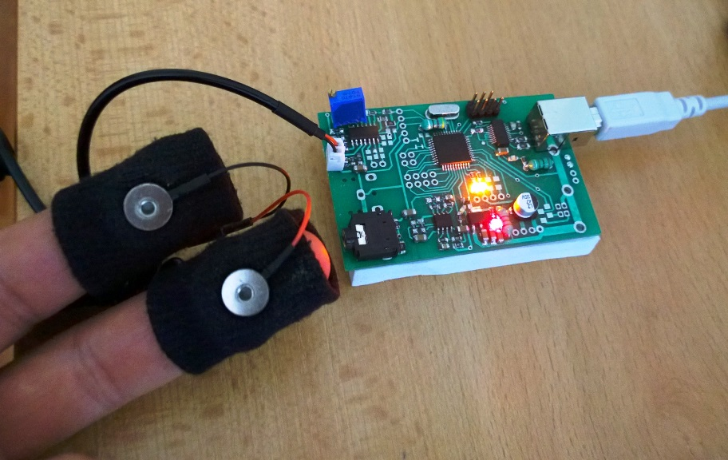
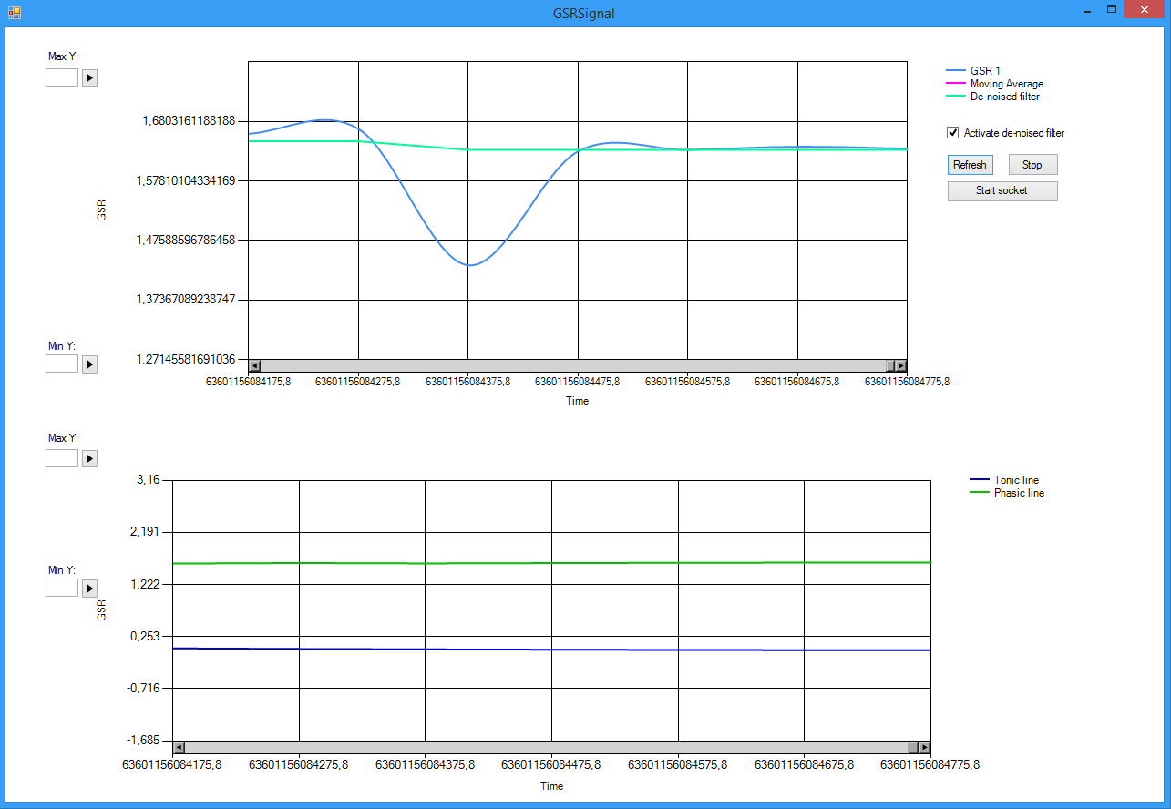
Affect inferred by psychophysiological signals
EDA (Electro-Dermal Activity)
Custom EDA meter – custom hardware device and software (H2020 RAGE asset developed by a team of FMI-SU)

Slide 10
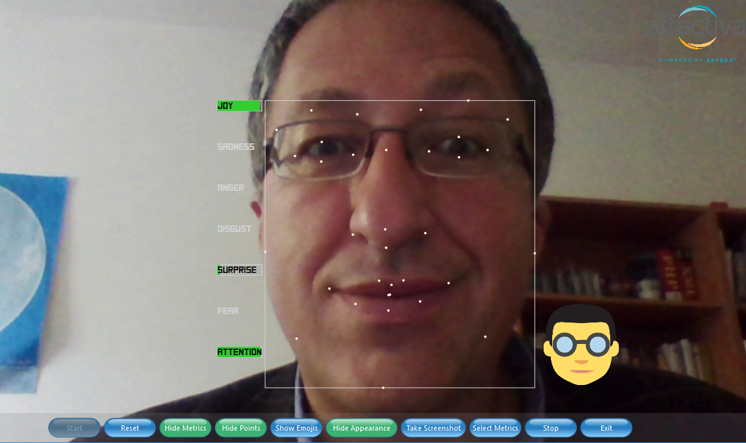
Emotions inferred by visual expressions analysis
Custom emotion recognizer using Affectiva SDK
Recognizes: sadness, disgust, anger, surprise, fear, joy; engagement, attention (fixation), eye closures (saccades)

Slide 11
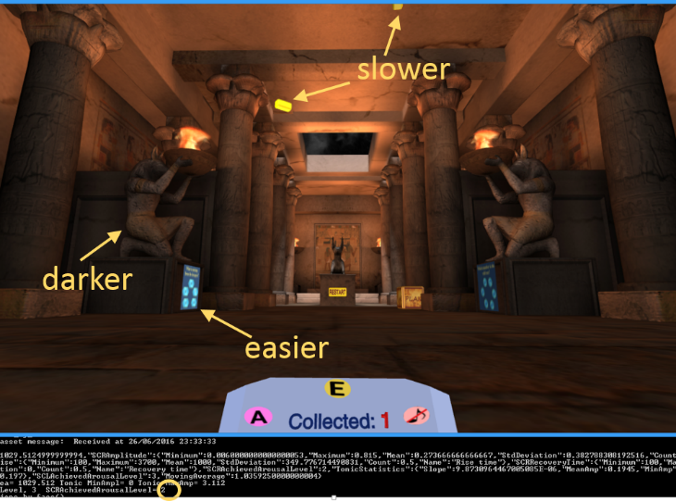
Emotion-based game adaptation 1/2
Adaptation of flying objects’ velocity, puzzle difficulty, and ambient light for lower phasic arousal

Slide 12
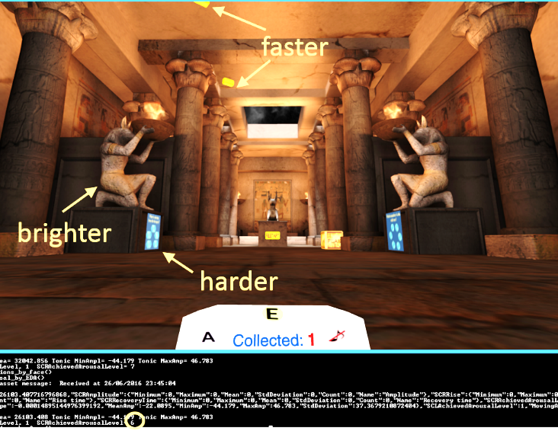
Emotion-based game adaptation 2/2
Adaptation of flying objects’ velocity, puzzle difficulty, and ambient light for higher phasic arousal

Slide 13
Current research in the scope of the MOTIVATE project
Modeling intelligent tools for adaptive and personalized educational STEM video games (MOTIVATE) - https://motivate-bg.online/
Aims at the integration of affordable eye-tracking technology and its applications into game-based learning:
applying adaptive learning strategies
in intelligent educational game-based environments
for personalized game-based learning experiences

Slide 14
Eye-tracking based game adaptation
Four key components:
an eye-tracking interface that dynamically captures and analyzes learners' eye tracks, saccades, and gaze data;
an adaptive gaming engine that interprets this data to modify in real-time both the:
gameplay and
didactic content;
a built-in player’s feedback mechanism that provides insights to both learners and educators regarding the expected enhancement of:
learning progress
engagement and motivation, and
excitement and UX,
together with a player evaluation of the affective loop (i.e., the parameters of the positive/negative affective feedback).

Slide 15
Workflow
Basic workflow:
The eye-tracking interface is applied for detection patterns in eye movement, saccades, and gaze behavior, to identify topics/areas of interest and potential challenges faced by the learner.
Next, this information is used by the adaptive game engine to tailor both the gameplay and learning content integrated within the game.
By adjusting the challenges that align with both the current cognitive and emotional state of a particular learner, the adaptive educational game is expected to provoke and report:
a sustained engagement for achieving a better learning motivation and gaming experience, and
together with a player evaluation of the affective loop.
Additionally, the feedback mechanism could help educators understand individual learning dynamics and facilitate informed instructional decisions.

Slide 16
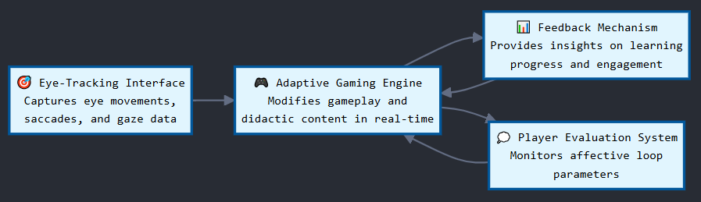
Basic component diagram

Slide 17
Eye-Tracking
Interface
Eye-Tracking Camera
Eye-Movement Capture
Saccade Detection
Gaze Pattern Analysis
Real-Time Data Processing
Finding Area of Interest
Challenge Identification
Adaptive Game
Engine
Data Interpretation
Feedback Mechanism
Adaptation Decision Logic
Engagement Metrics
Motivation Assessment
Cognitive & Emotional State Assessment
Challenge Level Calibration
Affective Loop Mechanism
Learning Progress Analytics
Affective Loop Monitoring
Negative Feedback Tuning
Gameplay Modification
Didactic Content Adjustment
UX & Excitement Evaluation
Positive Feedback Tuning
Affective Loop Analytics
Educator
Game Tasks
Learner Dashboard
Educator Insights Panel
Affective Feedback Assessment
Learner
Detailed component diagram

Slide 18
Important issues
Identification of area of interest and challenge perceived by the player
Real-time assessment of engagement and motivation
UX and excitement evaluation
Monitoring the affective loop by combining positive and negative feedback
Affective analytics
Learner progress analytics

Slide 19
Conclusions
The suggested architecture integrates relatively cheap and affordable eye-tracking technology into adaptive educational video games and virtual reality environments, in order to create more personalized educational experiences.
Thus, such environments are supposed not only to enhance game-based learning engagement but also to improve learning outcomes.
Intelligent educational environments, applying eye-tracking-based adaptation, provide a significant opportunity to achieve personalized learning that is more effective and responsive to the needs of each learner.

Slide 20

Thank you for your attention!
Контакти:
bbontchev@fmi.uni-sofia.bg
ddessy@gmai.com
valentina.terzieva@iict.bas.bg
Благодарност:
Изследването, довело до тези резултати, е финансирано по проект MOTIVATE, финансиран от Фонд „Научни изследвания“, Договор за безвъзмездна финансова помощ № КП-06-Н85/2 от 12.05.2024 г.
Q & A

